Slide 1
Why use the Superior Wall System
Custom built-
Your entire custom foundation is designed and built at the plant. Every detail is planned and executed using computer assisted designs, and an expert crew. You may request wall heights of 4, 8, 9 and 10 feet, with 11 and 12 foot walls coming in 2015.
Every wall system is tested and verified by a third party inspector in order to be sure your foundation is correct, complete and strong for decades to come.

Slide 2

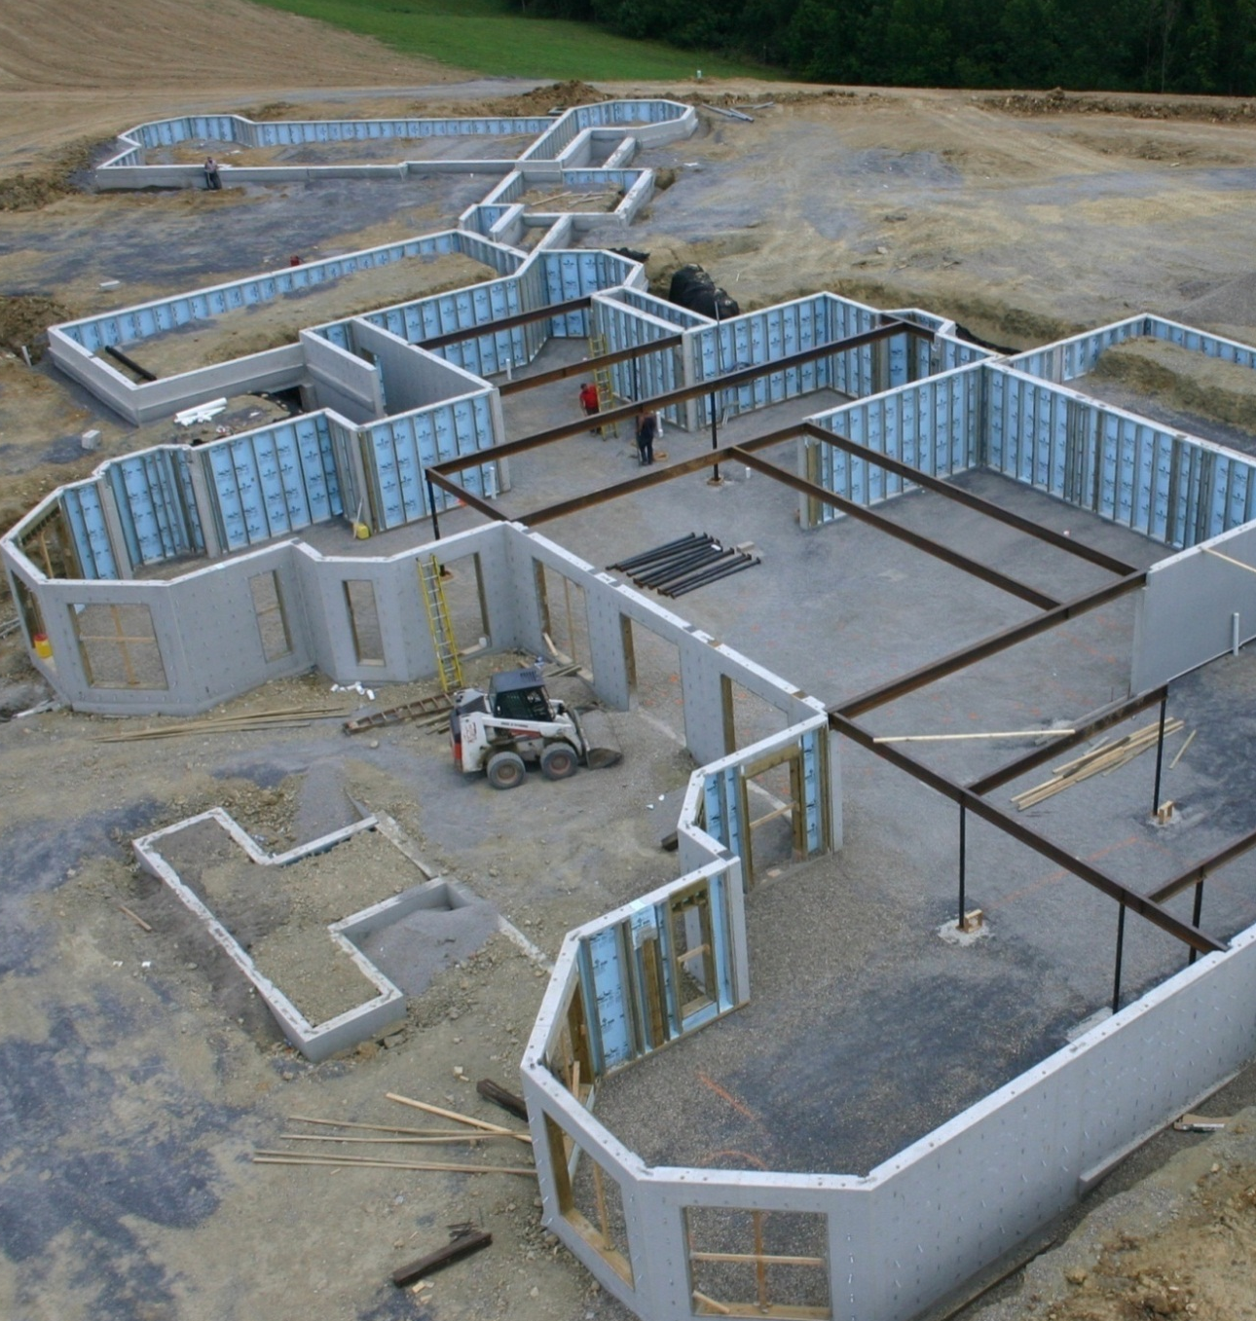
Create more living space with a Superior Foundation
GUARANTEED
15
YEARS
©2011 Superior Walls of America, Ltd.
Notes:
Not just for the small modular home. The walls are very popular with high-end home builders who want to offer their customers the best features.
Longest warranty of any foundation. What other foundation company puts their phone number right on the wall?
We mention the walls as being used for foundations mostly because that is what they are used for predominately.
This particular custom home is built with an R-5 foundation that is located on top of a hill in Ohio. As we go through the presentation you will see pictures of different wall systems.
What kind of observations can we make from this picture?
It is difficult to see in this picture but these precast walls are cavity style precast walls as opposed to solid, or hollow-core.
These walls are being used for as foundation walls, above grade walls and completely buried garage walls.
There are a significant number of openings for windows and doors.

Slide 3
Why use the Superior Wall System
Installs in 2 days
The wall system comes to the site already cured, and is placed in the ground in 1-2 days by our highly experienced and trained set crew. Once the first floor is attached, the rest of the house can go up quickly. Our wall system can even be installed in winter time conditions. The framers will have a wall system that is plumb, true, and ready to build on. This saves time, reduces the days needed to finish the house, and gets the homeowner into their new house sooner.

Slide 4
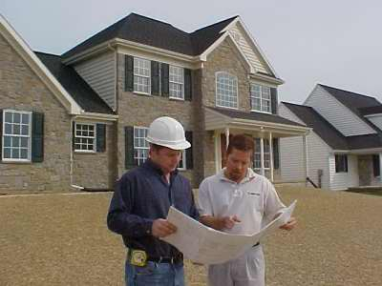
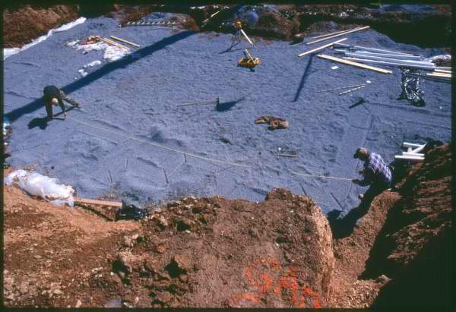
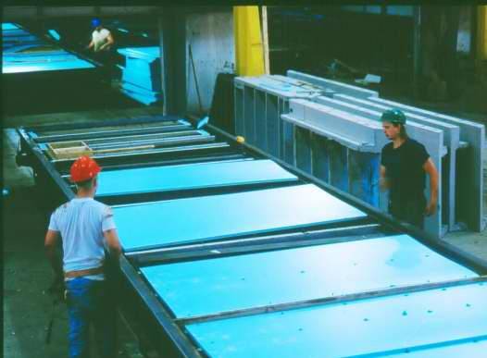
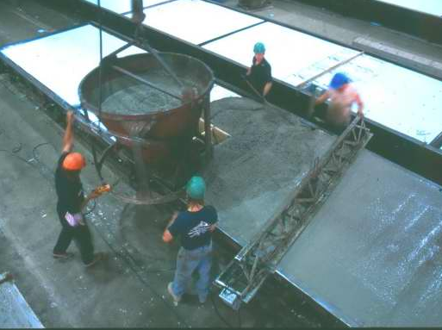
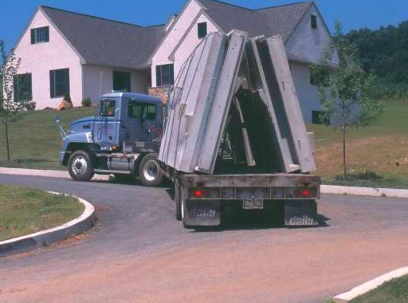
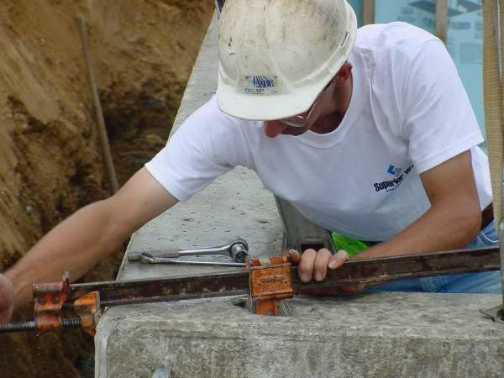
The Superior Building Process
Architect creates blueprints
Excavator prepares site
Insulation set (Superior Walls factory)
Concrete poured (Superior Walls factory)
Certified Superior Walls crew completes installation
Walls delivered by trailer

Slide 5
Why use the Superior Wall System
Meets all of today’s codes
Today’s houses have to meet today’s codes for safety, dampness, insulation, and more. The Superior wall system is built at the plant to meet today’s code requirements.
Superior walls insulation has passed all codes for fire and
smoke barrier testing. Your family will be warm, dry, and
safe, whether you finish the basement, or leave it unfinished.

Slide 6
Why use the Superior Wall System
A Superior Wall is Environmentally Sound
Our wall system carries with it a Green Build certificate. This includes the value points associated with the certificate.
Our unique product uses 70% less concrete than conventional walls, and is cured at the plant. There are no toxic gases released as in conventional concrete walls.
It leaves no environmental cleanup issues like extra concrete, and pitch used in damp proofing concrete.
There are no toxic chemicals used on site to free the forms from the wall, since the panels are made at the plant and come ready to install.

Slide 7
Why use the Superior Wall System
Warm, Dry, and Safe, with a 15 year warranty
From the day you move in, you will feel the difference with a Superior Wall system. Your basement will be warm, dry, and safe for your family.
“Our basement is not finished but is used for exercise, ping-pong and other games as well as family visits, gatherings and storage. We use no heat or air-conditioning, but all year the basement does not vary more than about 10 degrees, and is always livable and comfortable for our use! No wet walls, no seepage, no powdery looking “stuff” building up anywhere! If we wanted to finish the basement and/or any part of the basement it is all ready to place the finishing products!” The Baum Family, Womelsdorf, PA

Slide 8
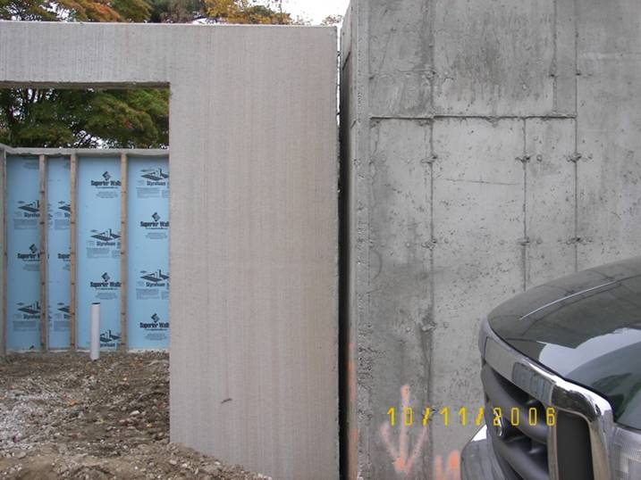
Superior Walls brush finish vs PIP finish

Slide 9
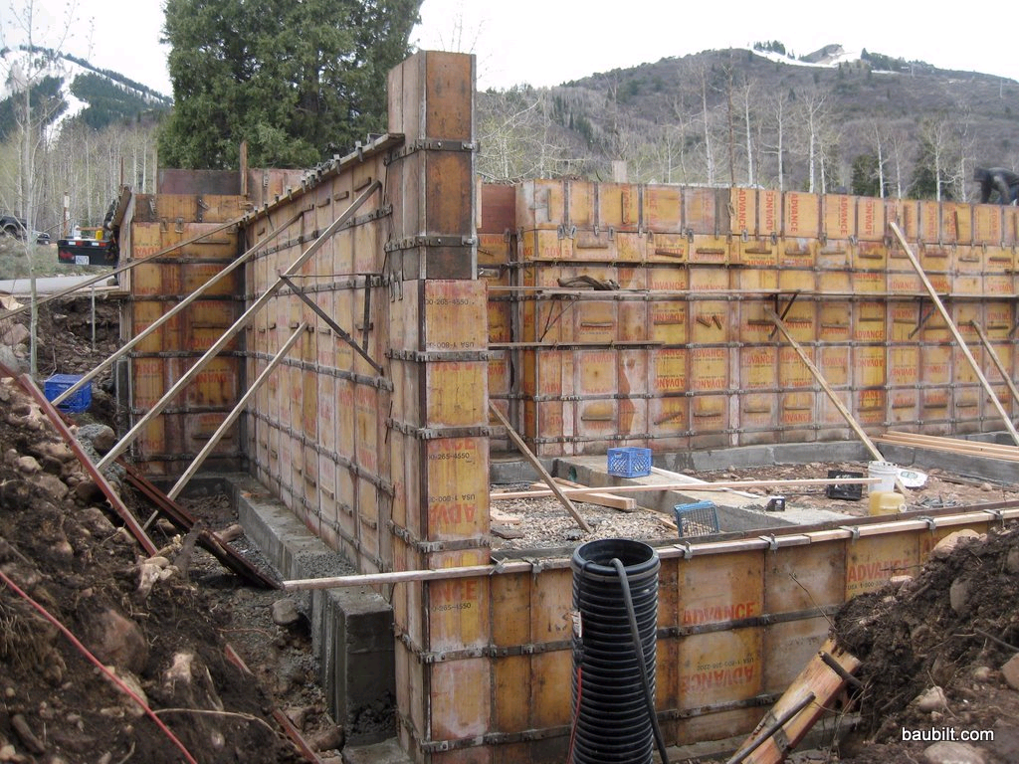
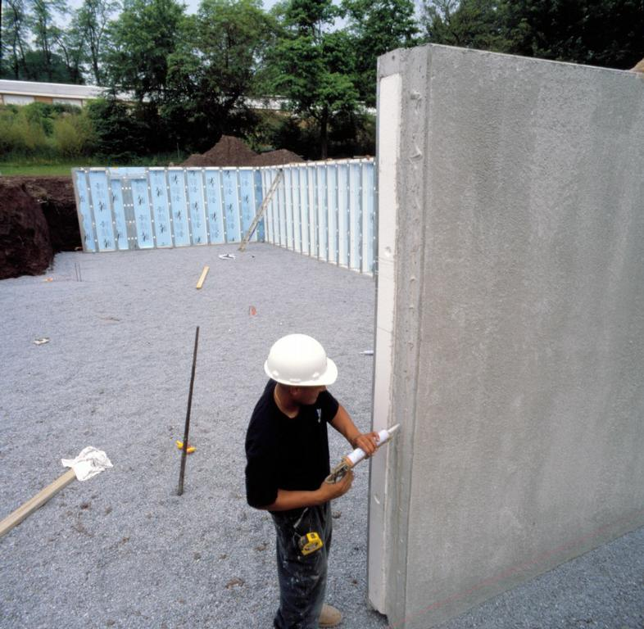
SUPERIOR WALLS USE NO FORM OIL, REQUIRE NO DAMP PROOFING & CREATE NO ON-SITE WASTE CERTIFIED BY THE NAHB

Slide 10

Superior Features
Superior Walls
Traditional Foundation
Built-in features
Insulated
Studded
Precast access holes
Damp proof
Footer included
Installs in hours
Yes
Yes
Yes
Yes
Yes
Yes
No
No
No
No
No
No

Slide 11
Why use the Superior Wall System
Prepared to finish at any time
Superior walls come standard with metal studs, insulation, and electrical cut outs, making your basement ready to finish when you are ready.

Slide 12
Why use the Superior Wall System
Added value to your home
Because you have chosen a Superior wall system, your home will increase in value more than with a simple concrete wall.
Energy savings have been reported by our homeowners, many of whom have had reduced energy bills, even when the basement was left unfinished.

Slide 13
Why use the Superior Wall System
Value for a lifetime- What goes into the ground cannot be changed or upgraded later. Your foundation is key to your house, so be sure you have the finest wall system in the world as your foundation.
Warm, Dry, and Safe…. Superior Walls!

Slide 14
